Slide 1
70 Seaview Road Boathouse Information Pack

Slide 2
Contents
Tree Protection Plan
Aerial View
Site Sketch
Outside Schematics
Inside Schematics
Flood Assessment questions & replies
Flood Assessment detail

Slide 3
Tree Protection
Plan
The base for the Boathouse will not extend over the core root system of any existing trees as specified in BS5837 (12x trunk diameter at breast height)
The base of the Boathouse will be built on recycled plastic legs and sit 30cm above the ground
All posts will be dug in by hand and any significant roots found can be avoided by moving the post positions
One tree is close to the work area, and will be protected with standard construction protection fencing during construction
No heavy machinery will be to cause compaction damage
Base of boathouse
Scale 2cm = 1m
Trees over 3cm Dia
Tree root systems
specified to BS:5837
Protective fencing

Slide 4
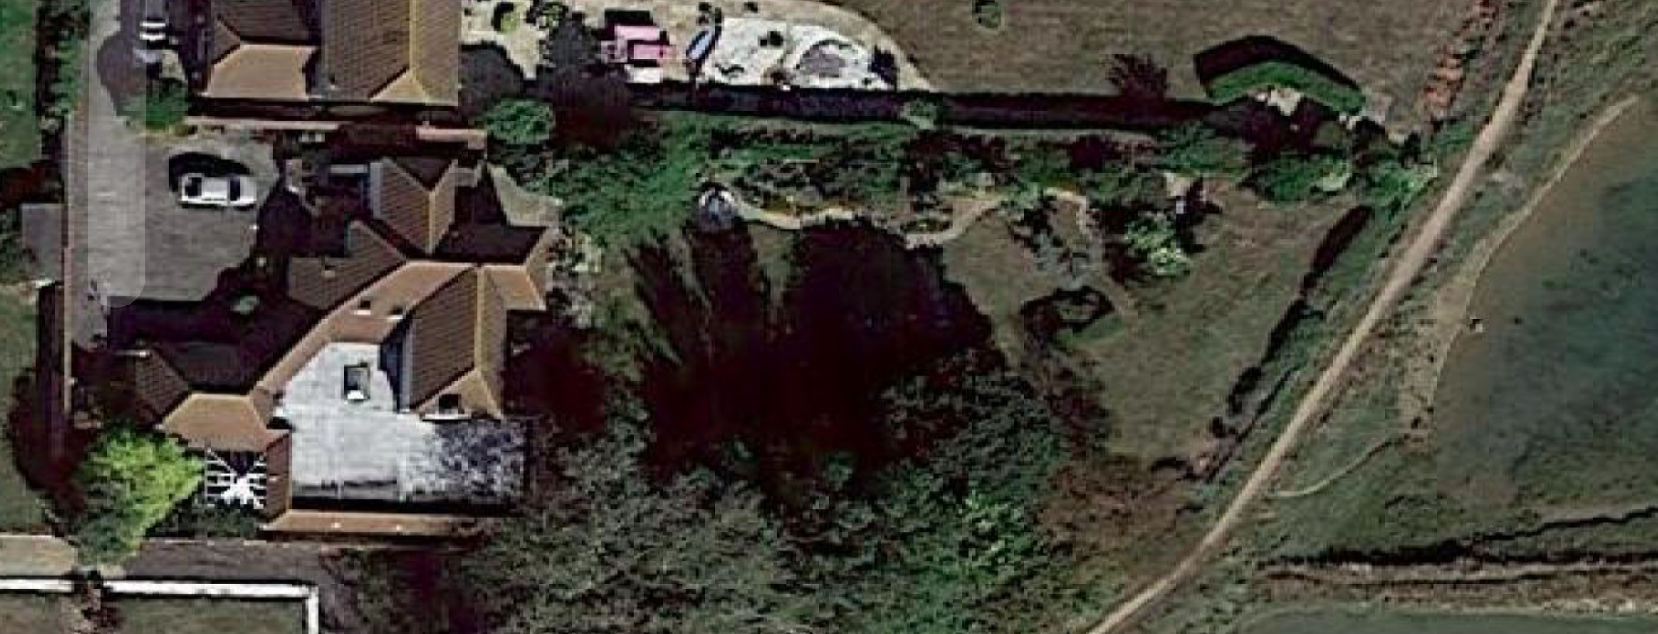
Aerial View – Proposed boathouse in green

Slide 5
Aerial view – Boathouse ‘invisible’ from harbour
Sea Defence
Hedges & trees
Existing
Summer House (>10 years)
Water Pipe to be laid
For cleaning boats/sailors
Chichester
Harbour
Path
Path to house
Proposed New Boathouse
Hedge
Trees
Trees
Thick Bushes
Hedge
Property Boundary
Route to Sea

Slide 6
Outside view
Window on North side
Double doors on East
Single door on West
3.4 m
3m
5m
Oak stained wood walls
Rubberised insulated roof
Stood on hand dug recycled plastic legs to protect tree roots
Raised 3” above sea defence level for flood protection
These dimensions are rough, see design for accurate

Slide 7
Inside view
1 m
2.5 m
Changing Area &
Dry Storage
Changing area
& Dry Storage
1 m
Sails
3.4m
1 m
Boat Storage
Canoe
Dingy
Sails
Dingy
Canoe
3m
5m
These dimensions are rough, see design for accurate

Slide 8
Flood Assessment for 70 Seaview Road Boathouse (minor extension) Proposal
your site address
  70 Seaview Road, Hayling Island, PO11 9PE
a description of your development
  Wooden Boathouse stood on plastic legs, with lower wet floor for boats, and a raised dry floor for clothes, changing, sails and other dry storage
an assessment of the flood risk from all sources of flooding for your development, plus an allowance for climate change
  See next page. Boathouse Dry Floor will be 97cm above highest storm surge (1 in 200 years) after 30 years of climate change (Higher estimate)
the estimated flood level for your development, taking into account the impacts of climate change over its lifetime
  Given maintenance of the current sea defences there should be no flooding in 30 years allowing for climate change (Higher estimate)
  Coastal Partners proposal is to raise sea defences from 2032 – if this were to happen it would make flooding less likely
details of the finished floor levels
  See next page
details of your flood resistance and resilience plans
  There is an existing sea defence across the foot of the property which has never been breached
  We intend to continue to raise the current sea defences in line with sea level rise through regular adding of topsoil
  Coastal Partners plan to increase the sea defences starting 2032 Draft Hayling Island Coastal Management Strategy Oct 2022 by coastalpartners - Issuu
  Boathouse will be stood on plastic legs, and the dry floor is 97cm above highest expected storm surge in 30 years
any supporting plans and drawings
  See next page, following pages, and submitted plans
any other information the relevant standing advice tells you to include

Slide 9
Flood Assessment
Boathouse Dry Floor will be 97cm above highest storm surge allowing for 30 years of climate change
Dry Floor
100 cm
Today
+30 years
Climate Change*
Wet Floor
Boathouse Dry Floor
453 cm
453 cm
45cm
Recycled Plastic Legs
Boathouse Wet floor
353 cm
353 cm
* Flood risk assessments: climate change allowances - GOV.UK (www.gov.uk)
Existing sea defences**
352 cm
374 cm
1 in 200 Year surge***
338 cm
360 cm
**We are planning on raising these in line with sea level rise. Costal Partners Plan to raise these starting 2032
Draft Hayling Island Coastal Management Strategy Oct 2022 by coastalpartners - Issuu
Site Lowest level***
308 cm
308 cm
Maximum normal local tide level
273 cm
295 cm
Ordnance Datum Newlyn
0 cm
0 cm
***Environmental Agency Assessment - point 3 see file attached (point 5 not used due to inconsistency)

