Slide 1
Slide Pack
Teams Meeting with LPA
Phase 2 Wetland Design Concerns
4 July 2024

Slide 2
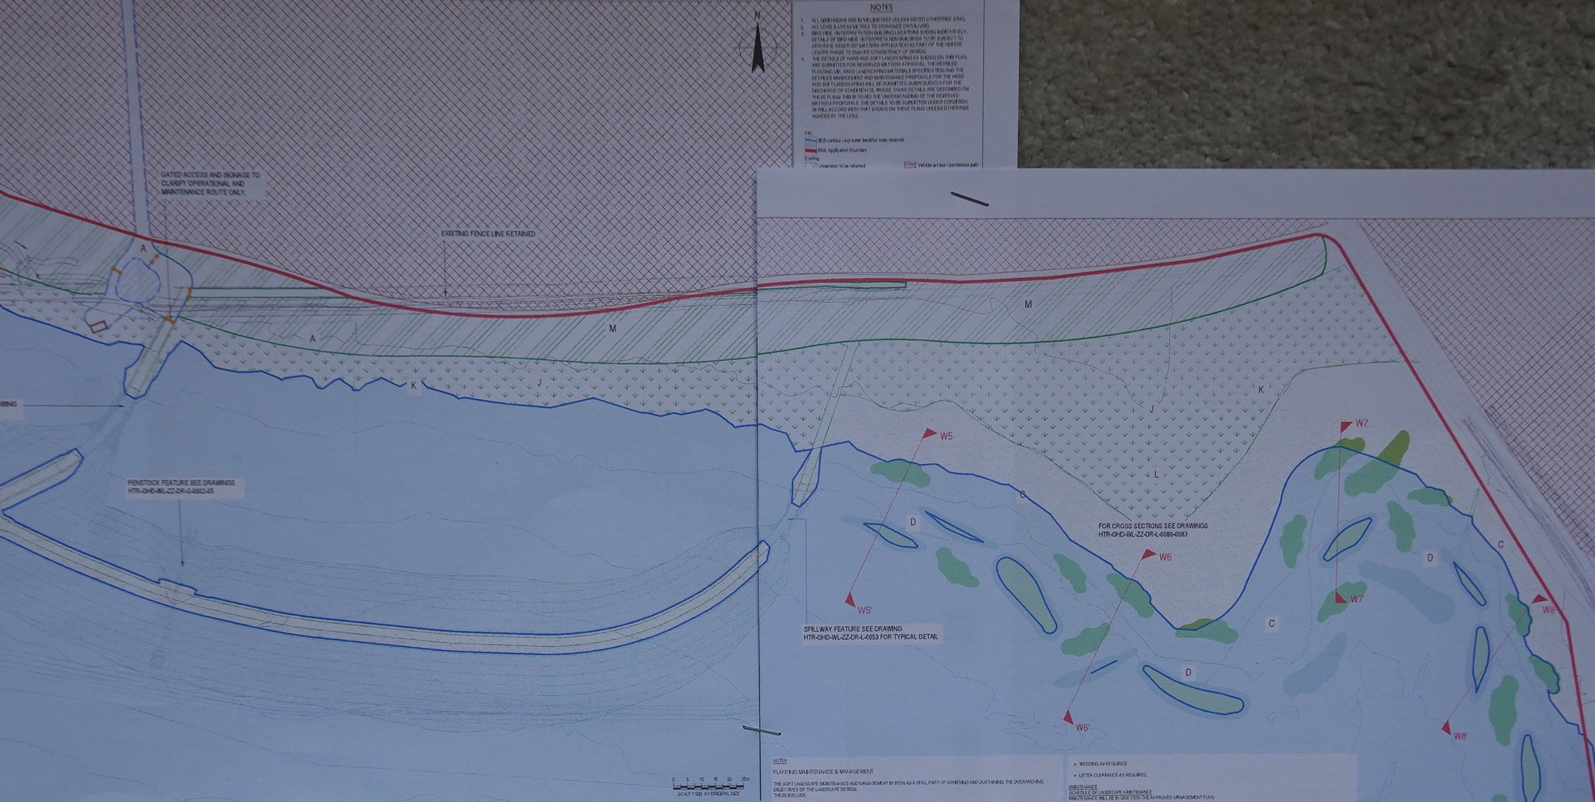
Compartment 0 – Ephemeral shallows added, but not generally orientated SW/NE to the prevailing wind, to take advantage of wave fetch, as per the Outline Design (Page 24/25 of Wetland Outline Design Technical Note)
Erosion will be a significant problem for islands with their flat edges facing the SW prevailing wind.
Compartment 1; pretty flat, very gently dips south. Wetland experts strongly recommended that habitat diversity needed to be added to prevent predator access (perimeter channel), with interconnecting channels to provide wider scraped/ scalloped edges to increase habitat complexity in the reedbed, to optimise its biodiversity potential, hold water for longer. This was included in the Outline Design (Tech Note pg. 25)

Slide 3
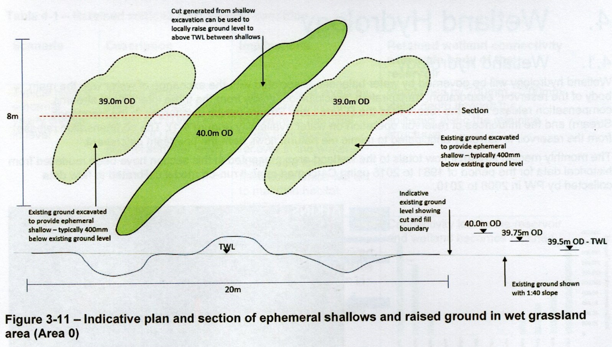
Why is the orientation of the ephemeral shallows important? (Extract of Page 25 Outline Design Technical Note)
Orientation SW/NE was to allow prevailing wind to drive water into the shallows and over the grassland providing regular inundation of the shallows from inland wave propagation, creating more prolonged wetting of the shoreline habitat.
As water levels drop shallow scrapes/ pools remain wet for longer along the shore.
Islands tops are only just above normal water level so very vulnerable to erosion. Any island orientated more E/W will act like a barrier reef, reducing fetch onto the shore and will quickly be eroded. Thus quickly reducing the value of the newly created habitats.

Slide 4
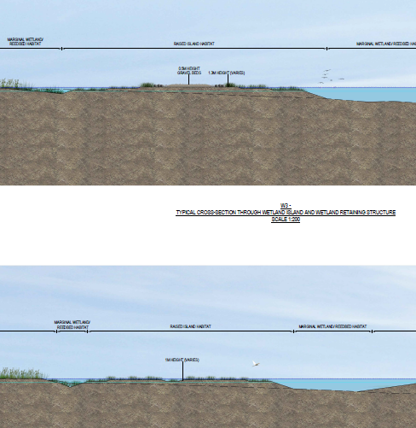
Water gap/ depth between wetland shore and the islands
Section WS3 top/ WS4 bottom
Can see gap between shore on left and islands is very narrow and shallow, so will quickly dry out as water levels seasonally retreat enabling predators to cross onto the islands, reducing their value as nesting bird habitat.
A stockmesh fence is ok for dogs but won’t keep a fox or weasel out.
Need a deeper water channel to protect the islands.
A deeper channel will also help to reduce spread of reed, which if it fills the gap will help foxes to cross more easily to the islands.
If reed spreads across the gap it will trap more silt which can impair flow around the islands & compartments. The depth of the channel needs to be enough to inhibit reed growth.

Slide 5
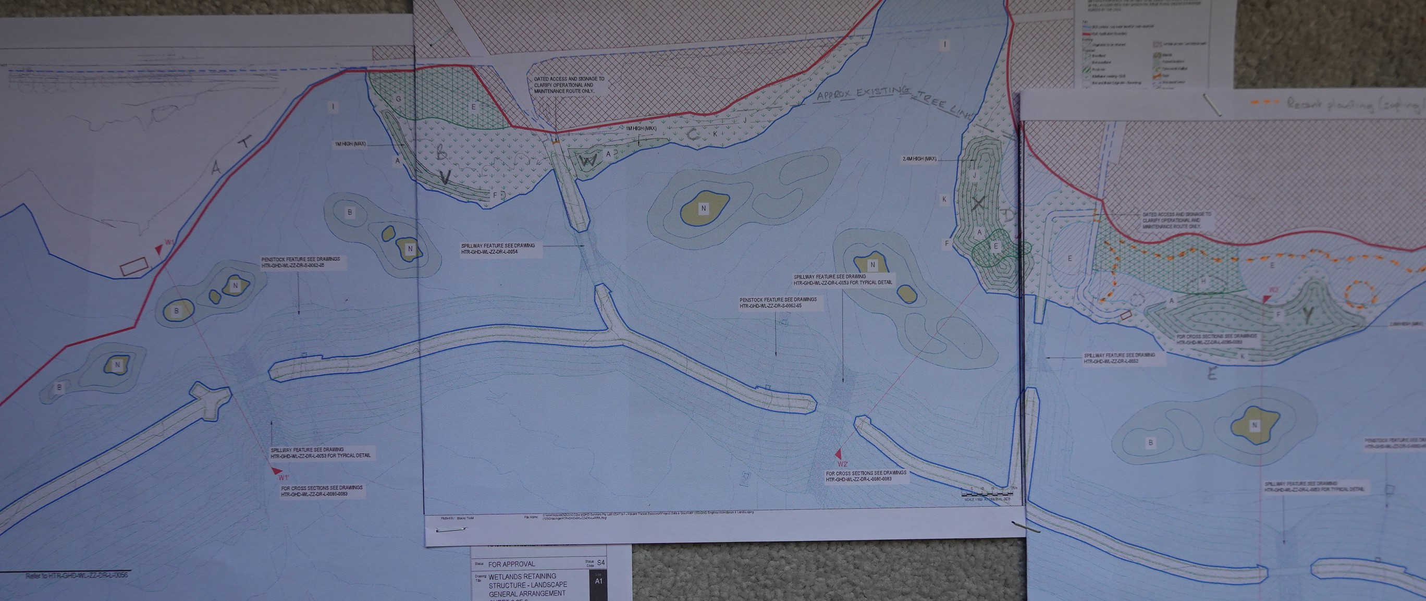
Mounds now shown in optimum areas of the shoreline (take up best areas away from FE track crossing and hides where disturbance is most likely)
The mounds impact most of the remaining shoreline, resulting in the loss of critical wet grassland habitat (Nov-April)
Natural transition from riparian habitat along shoreline to wet grassland & scrub/ woodland is lost across large areas (significant impact)
Natural wave fetch up the shallow sloping shore lost, reducing wetting of grassland.
We don’t need more raised dry areas, got >1.5 miles of raised embankment & >1mile of dry retaining structure/ bunds
Need more wet grassland to replace the habitats lost (including new additional wet grassland lost in the SW due to embankment changes).
Did an analysis to try and assess impact based on more than 35 years of experience managing wetlands.
Note: Expecting a mound along NW shore at ‘T’ as end shown on previously submitted cross section now withdrawn.

Slide 6
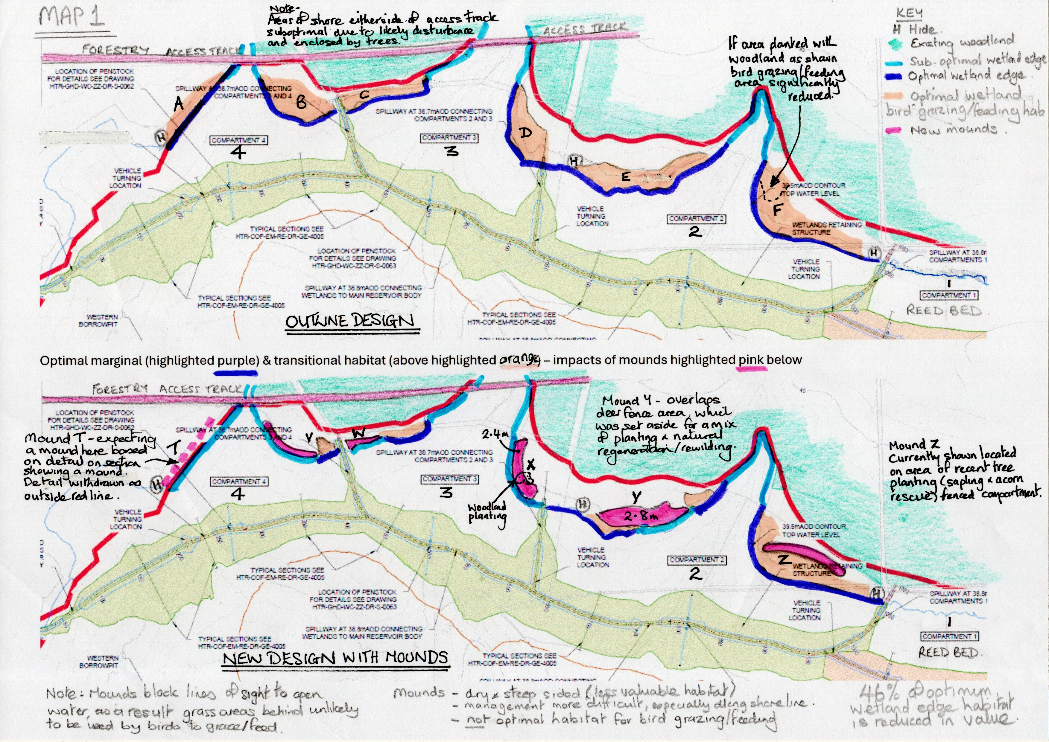
Orange area represents optimum wet grassland habitat which would be ideal for wetland birds to graze & feed (top outline design).
Introduction of mounds significantly reduces likely optimal feeding area as lines of sight to the water for birds feeding have been lost, which is critical.
While if managed as short grass the south facing slope of mounds closest to water could be used, the north slopes and grassland to north are much less likely to be used as no longer optimum habitat.
Note: Unlikely to be possible to manage mound slope esp. along shore with tractor. Management of slopes more difficult to create optimum habitats & likely to cause greater disturbance.
Estimate 46% of shore habitat could be reduced from optimal as a result of introduction of mounds along shore.

Slide 7
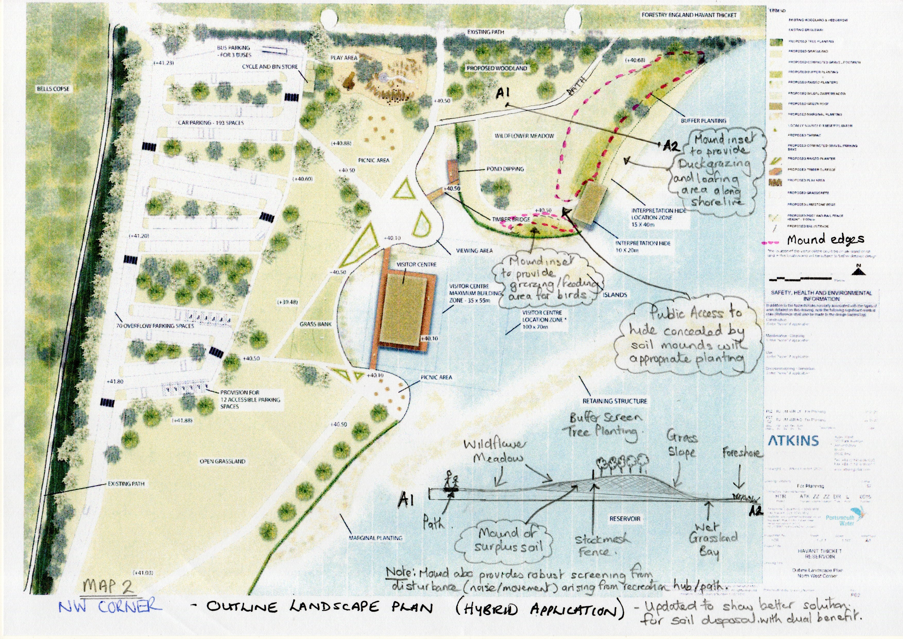
Feel mounds are more to do with disposing of excess soil rather than creating a useful habitat.
Alternative solutions that don’t adversely impact biodiversity net gain.
- Put in borrow pits
- Widen retaining or compartment bunds slightly
- Place a screening bund in NW with long slope in the west blending into existing contours. Provides a double benefit as will screen wetland from busy NW visitor hub area.
- Use to create screening bunds adjacent to the hide locations. More robust than planting alone.

Slide 8
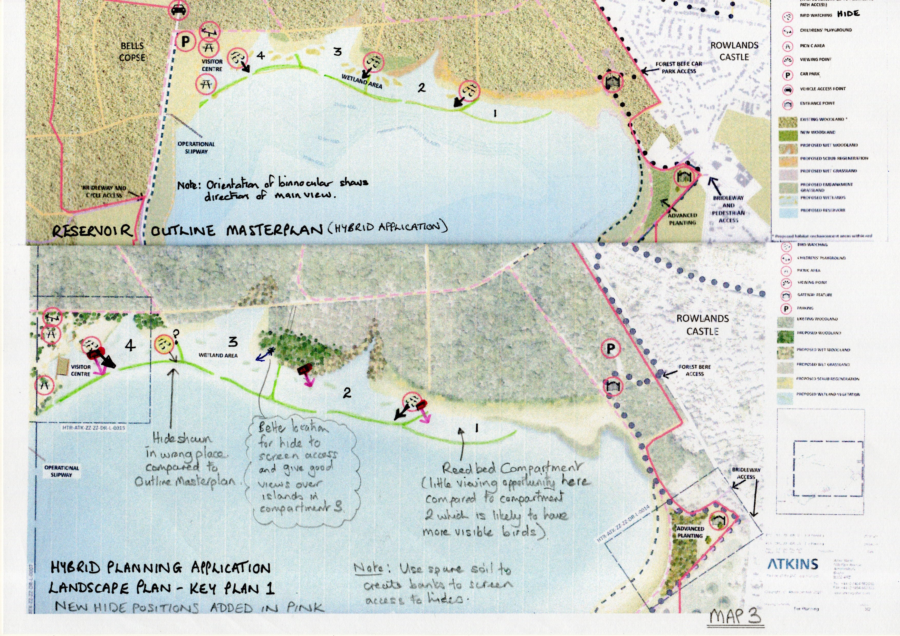
Applicant notes that hide locations are effectively being fixed as a result of the access points to them.
Which means that we do need to make sure that they are in the best locations now.
East hide – hide orientation needs to be to SW (poor light & most interest in comp 2. Screening of access not adequate to prevent disturbance.
Central hide – Location inappropriate with access south of screening.
Better to revert to original location and easier to screen if moved west

Slide 9
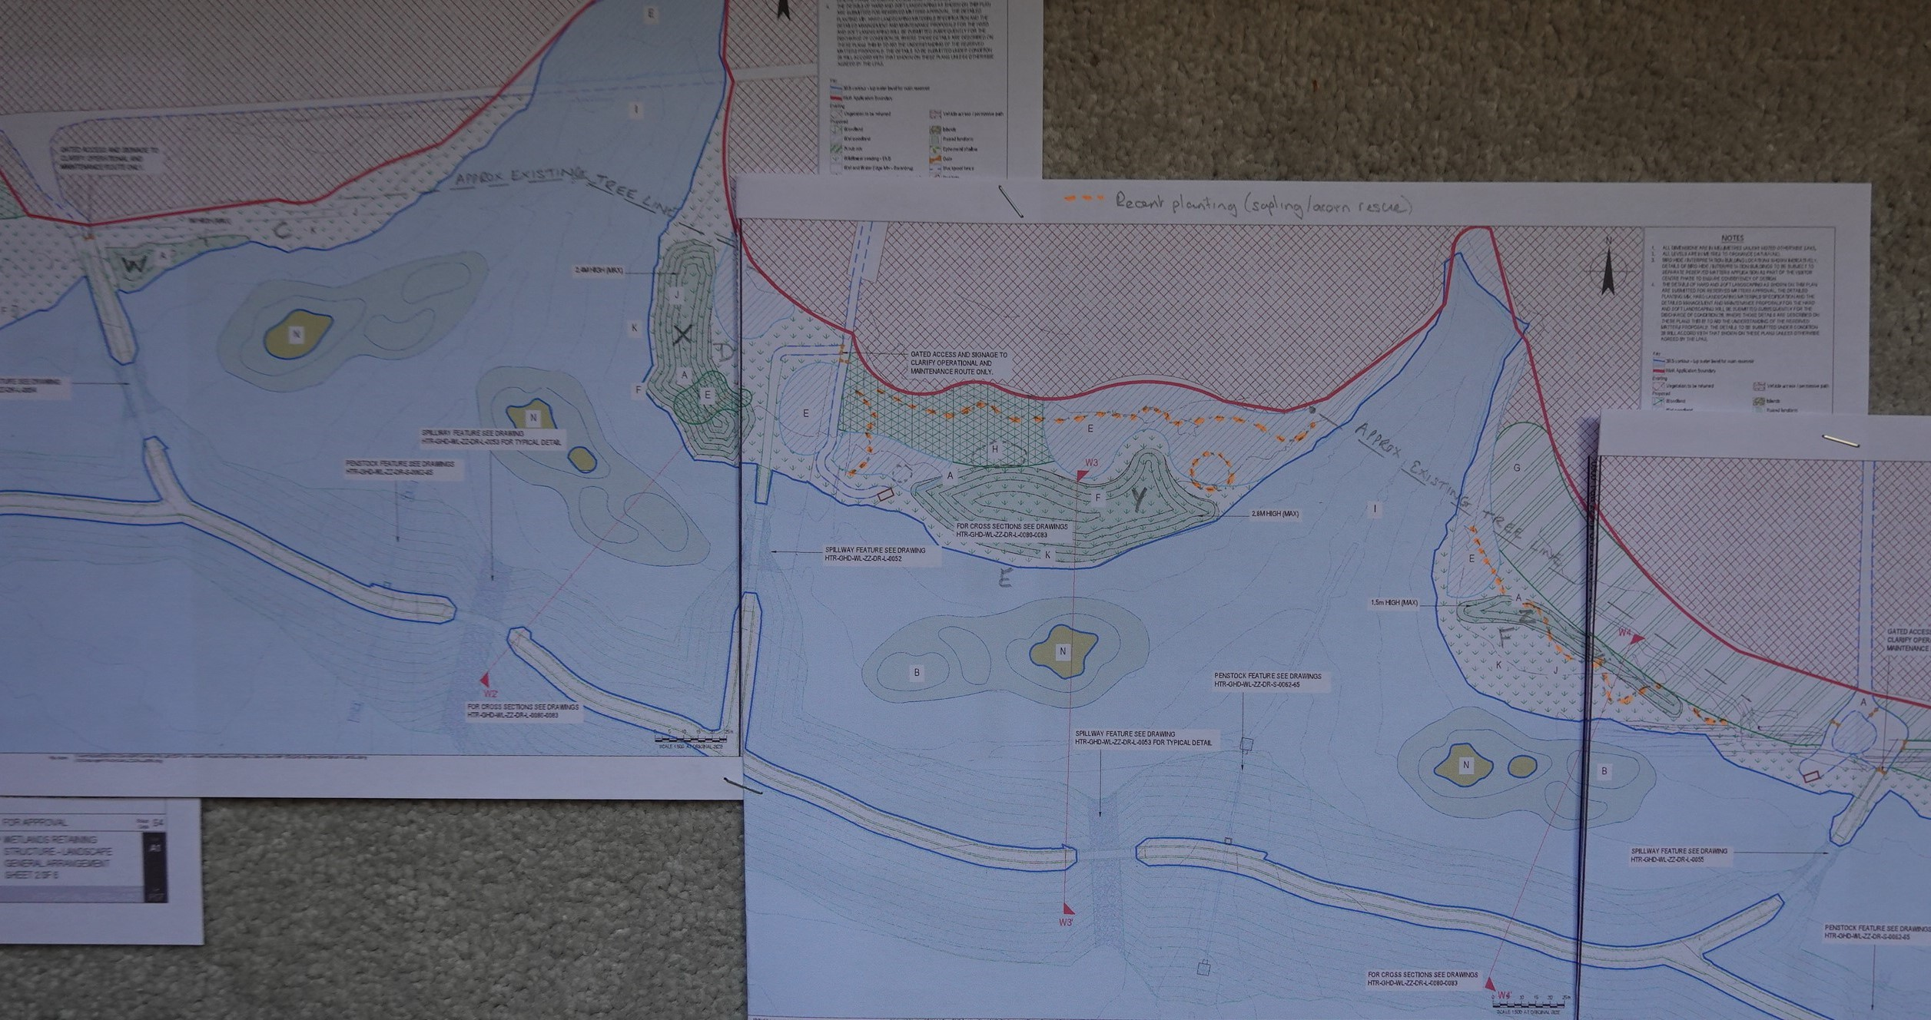
Note 1: Central hide 270 degrees view obscured by mound Y to the east.
Access to hide locations as shown not possible without causing disturbance. Locations can be adjusted to improve screening opportunities.
Mounds could be used to create a screened access with suitable planting, hides could even be raised within a screening mound to improve views.
Note 2: Mound Z in compartment 2 seems to be located on recent planting areas (acorn & saplings rescued from The Avenue ), within deer fenced area which I understood was to be a natural regeneration/ rewilding area?
Much of green area to north existing trees?
Note 3: Islands are not orientated to prevailing wind to reduce erosion risk.
Also not orientated towards hides to optimise viewing opportunities.

Slide 10
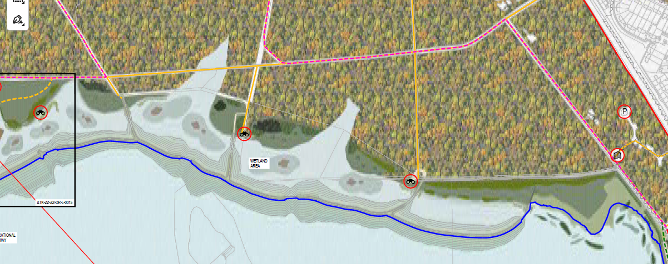
Would be better if central hide placed where shown on latest Outline Masterplan
- at end of existing track where screening on east side already exists
- could place on a raised mound to improve views over both compartment 2 and 3

Slide 11
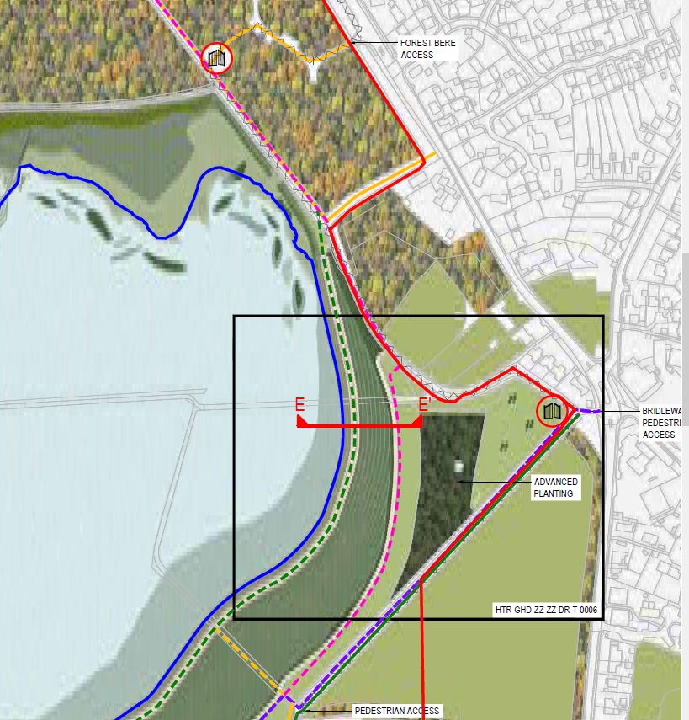
Discussion points:
Lack of space to enhance eastern wildlife corridor, especially at pinch point with paddock at risk of development.
No vehicle turning head. Operational & Ranger vehicles will have to use the narrow eastern boundary path, which is shared with walkers, families, cyclists & horses.
What discussions have taken place between LPA and the applicant?
Can LPA request a more detailed map of the Gipsies Plain area which covers the critical area of concern, before consent is granted?

Slide 12
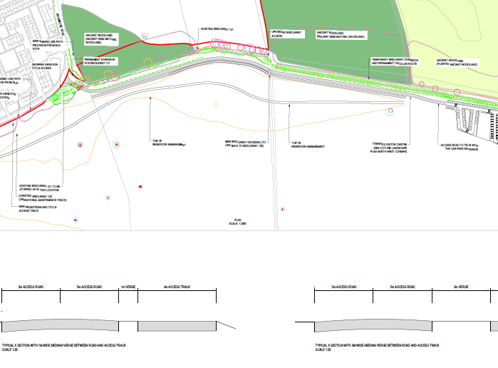
What is the status of this drawing with application 12 (Tower & Embankment)?
Does it result in consent for a two way road?
Not necessary as secondary route for locals, should be single lane with passing places.
Urbanises western boundary.
Leaves minimal space for landscaping.
No liaison with stakeholders.
Crest road does not link in NW?
Operational access road/ bridle/cycleway does not link in west?
ACCESS ROUTES
VEHICLE ACCESS ROUTE SOUTH
SHEET 1 OF 1

