Slide 1
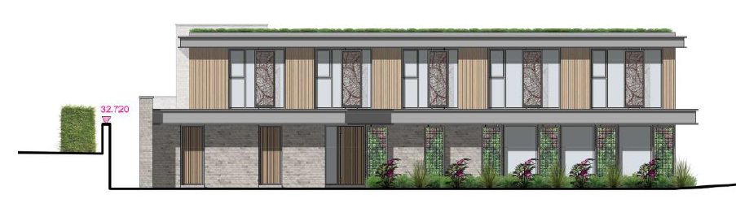
Whitsbury Road Logistics & Methodology plan

Slide 2
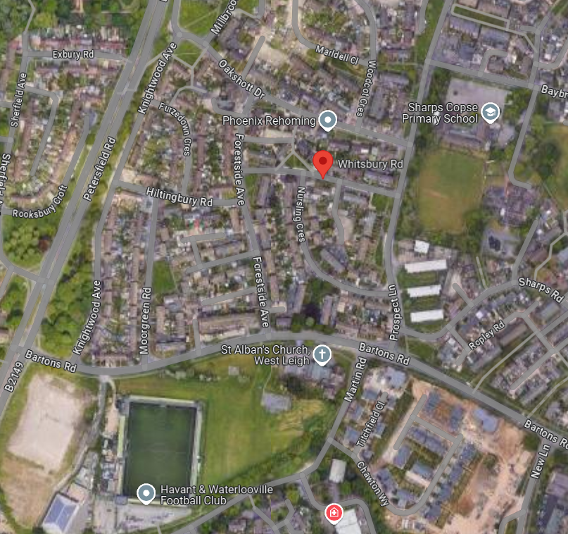
Access to site
Access to site will be
from the B2149 onto
Bartons Road.
From here, deliveries can
access via Prospect Lane
Or Forestside Avenue into
Whitsbury Road

Slide 3
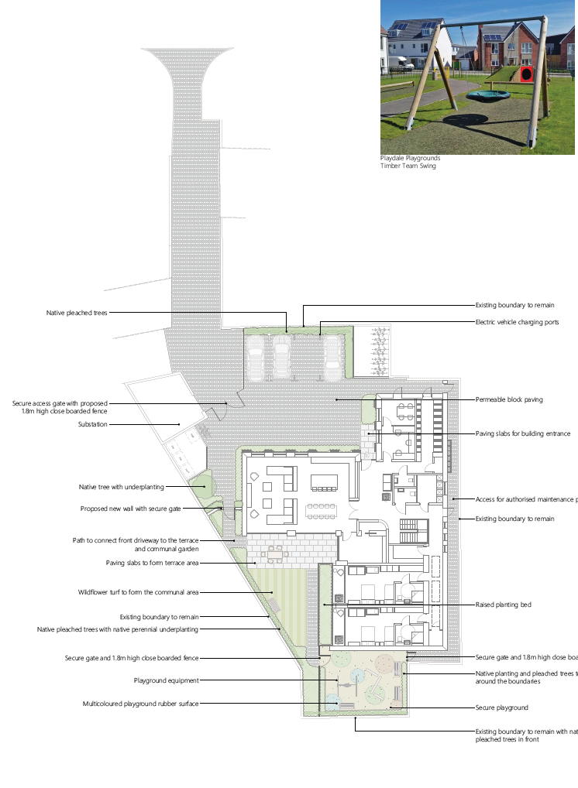
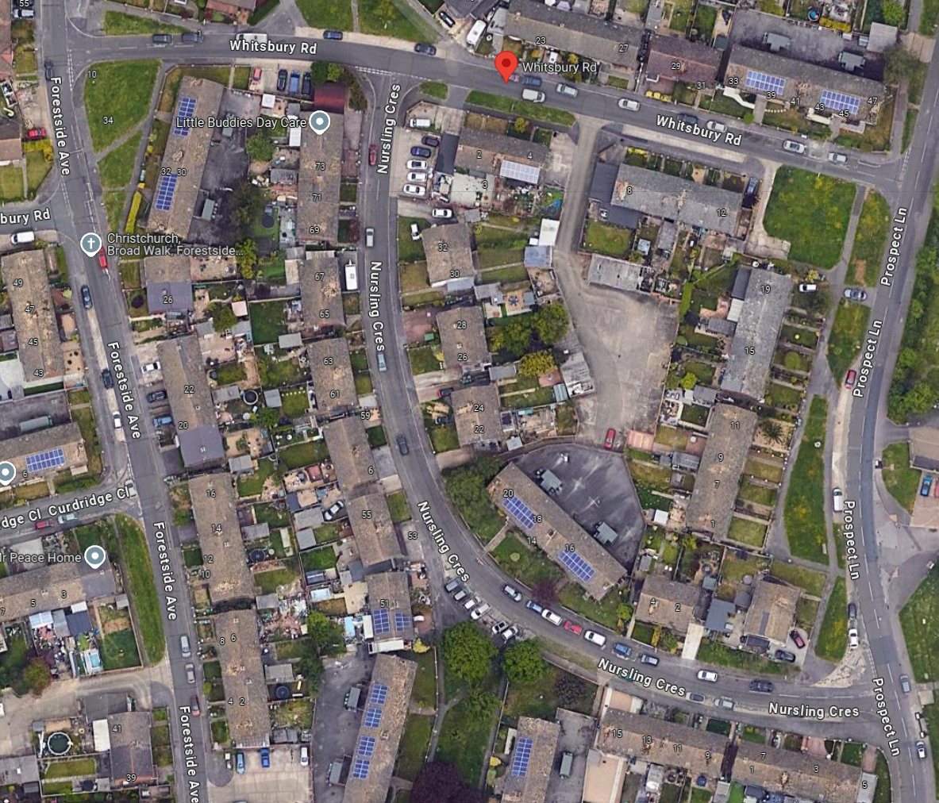
Access to site
Access onto our site will
be via small road and will
be controlled by a gateman
at a secure gate.
This will be set back to
enable lorries to pull off
Whitsbury Road.
A Pedestrian path will be
Located along this road

Slide 4
Contractor Parking
Due to the nature of the project and the
Complexities of available space there,
will be no possibility of onsite parking.
All operatives will be briefed by way of
Induction on the
VSC considerate approach
to our neighbours when parking and
travelling to and from the Project.
There is adequate parking availability
in surrounding
Roads such as Whitsbury, Nursling Cresent and Prospect
Lane

Slide 5
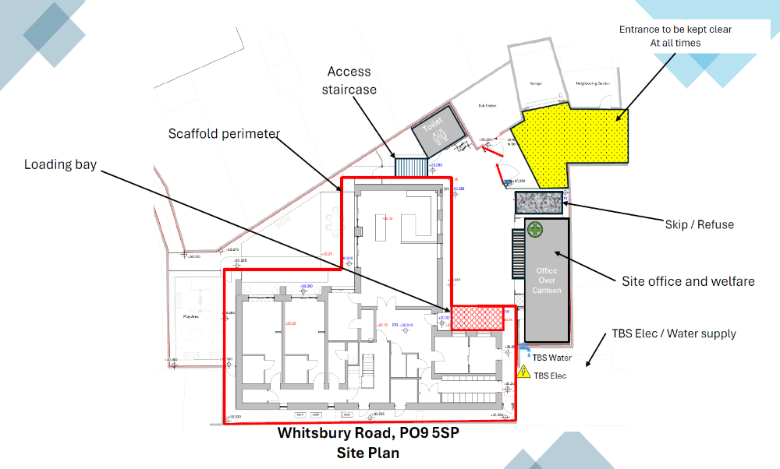
Material Storage
Materials will be procured and ordered
Under strict guidance of on time deliveries.
There Is little space available for excessive
Storage of materials due to the project
Logistics. When Construction of the main
Timber frame is completed the intention is to
Store minimal materials internally
should the in-time factor not be applied.
No storage will be permitted to
Any public area’s that may cause
Distress of annoyance to neighbouring
Properties.

Slide 6
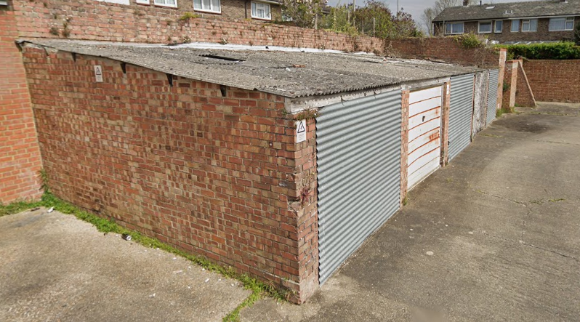
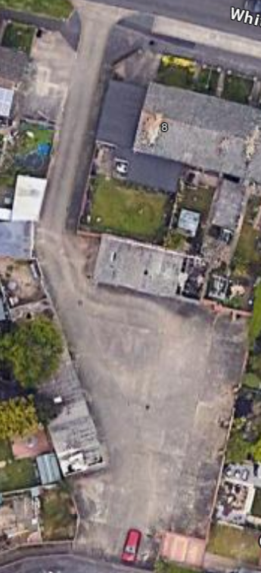
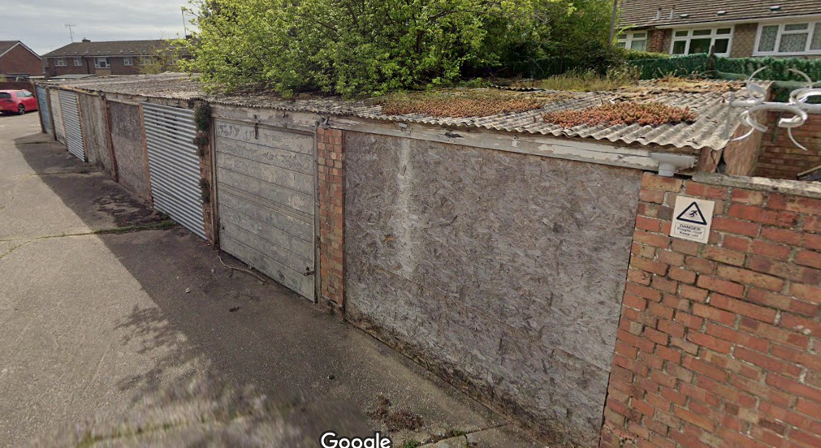
Removal of garages
Whilst removing the
asbestos roofs and
garages, we would use
a welfare unit with suitable
Gate at entrance to drive
When garage removed, we
Would install fencing as
required
When removing concrete slab, we will crush on site and re-use material on site where acceptable

Slide 7
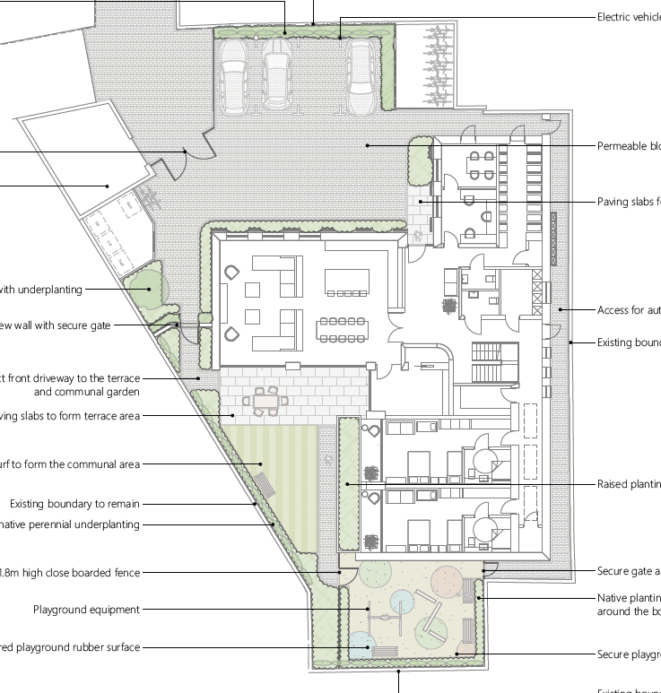
Substructure & drainage
Drainage, including offsite FW connection.
Incoming services infrastructure
Below slab drainage & ducts
Foundations, insulation and concrete slab
Site offices to be located adjacent substation (blue)
SITE OFFICE
TOILET

Slide 8
Superstructure
Scaffold to be erected for timber frame
Timber frame to be built using mobile crane (orange box)
Passivhaus inspection hold point
Roof coverings including PV’s
Brickwork to facades with scaffold adapted as required
Timber cladding, parapet cappings, RWG etc.
Scaffold to be dropped
SITE OFFICE
MOBILE CRANE
TOILET

Slide 9
Internal fitout
M&E and carpentry 1st fix
M&E & carpentry 2nd fix
Passivhaus inspection hold point
Plastering to walls & ceilings
Decorating, tiling, floor finishes
M&E & carpentry finals
Commissioning, final cleaning & Client demos
SITE OFFICE
TOILET

Slide 10
External works & landscaping
All scaffold has been removed
Site offices to be removed
Fencing
Paving
External furniture
Soft landscaping
TOILET
SITE OFFICE

