Slide 1
APP 26/00382 at15 Beach Road,
Hayling Island,PO110AA.
Pedestrian Visibility Drawing in accordance with HCC document HG3
Contact details: D Gorvin.
07766522683

Slide 2
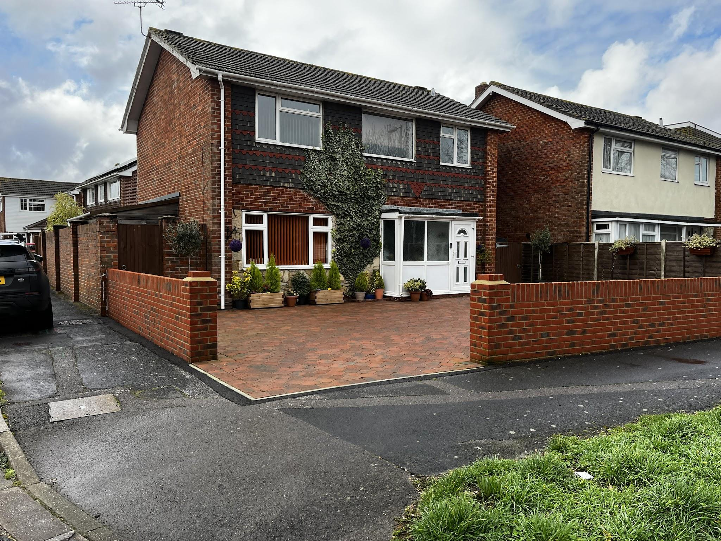
15 Beach Road, frontage and preferred location of new Highway dropped kerb adjacent to current pedestrian dropped kerb. In order to better distinguish between the pedestrian and vehicle dropped kerb, if required we can demolish the brick pier and rebuild 750mm to the north. This will increase the opening to 3500mm.

Slide 3
Beach Road
Pavement
<Opening onto footway 2800mm>
<2000mm>
<2000mm>
Height of brick pier and wall within visibility splay will be reduced to 0.6m high in perpetuity, or, the brick pier can be demolished and rebuilt 750 mm north.
Eye height 1.05 m

Slide 4
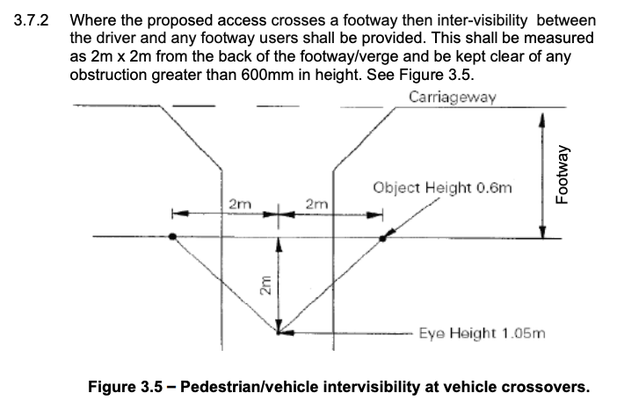
Extract from HG3

Slide 5
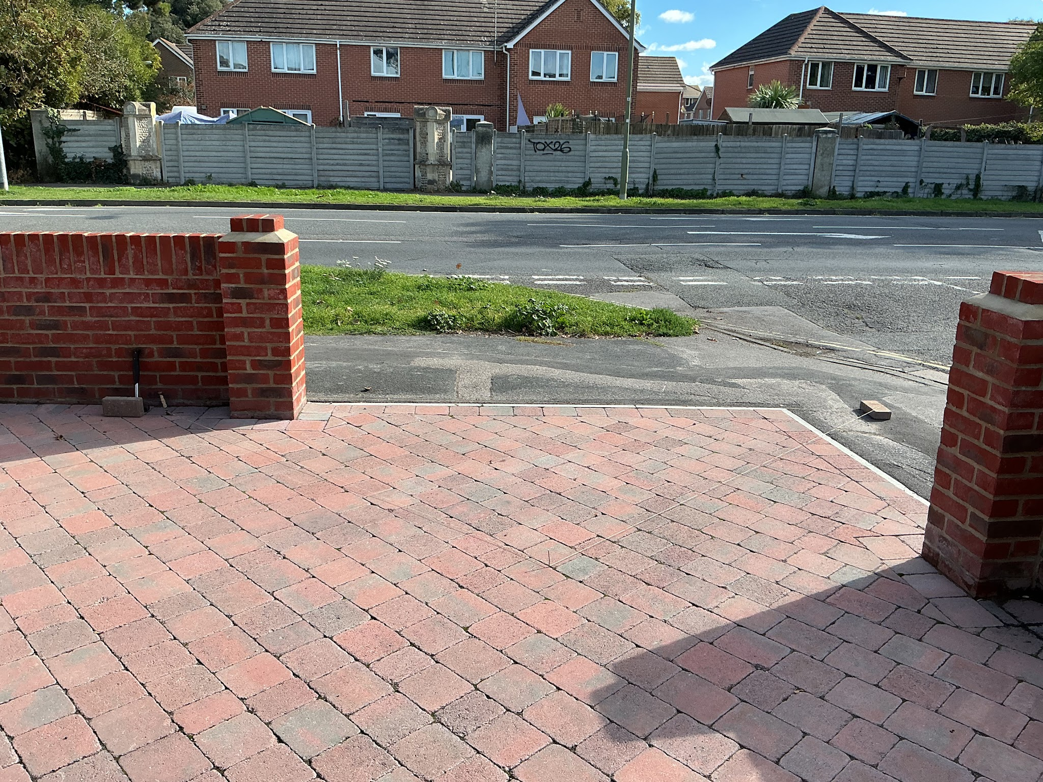
Inter-visibility splay 2mx2mx2m.

Slide 6
Examples of shared pedestrian/vehicle dropped kerbs locally.

Slide 7
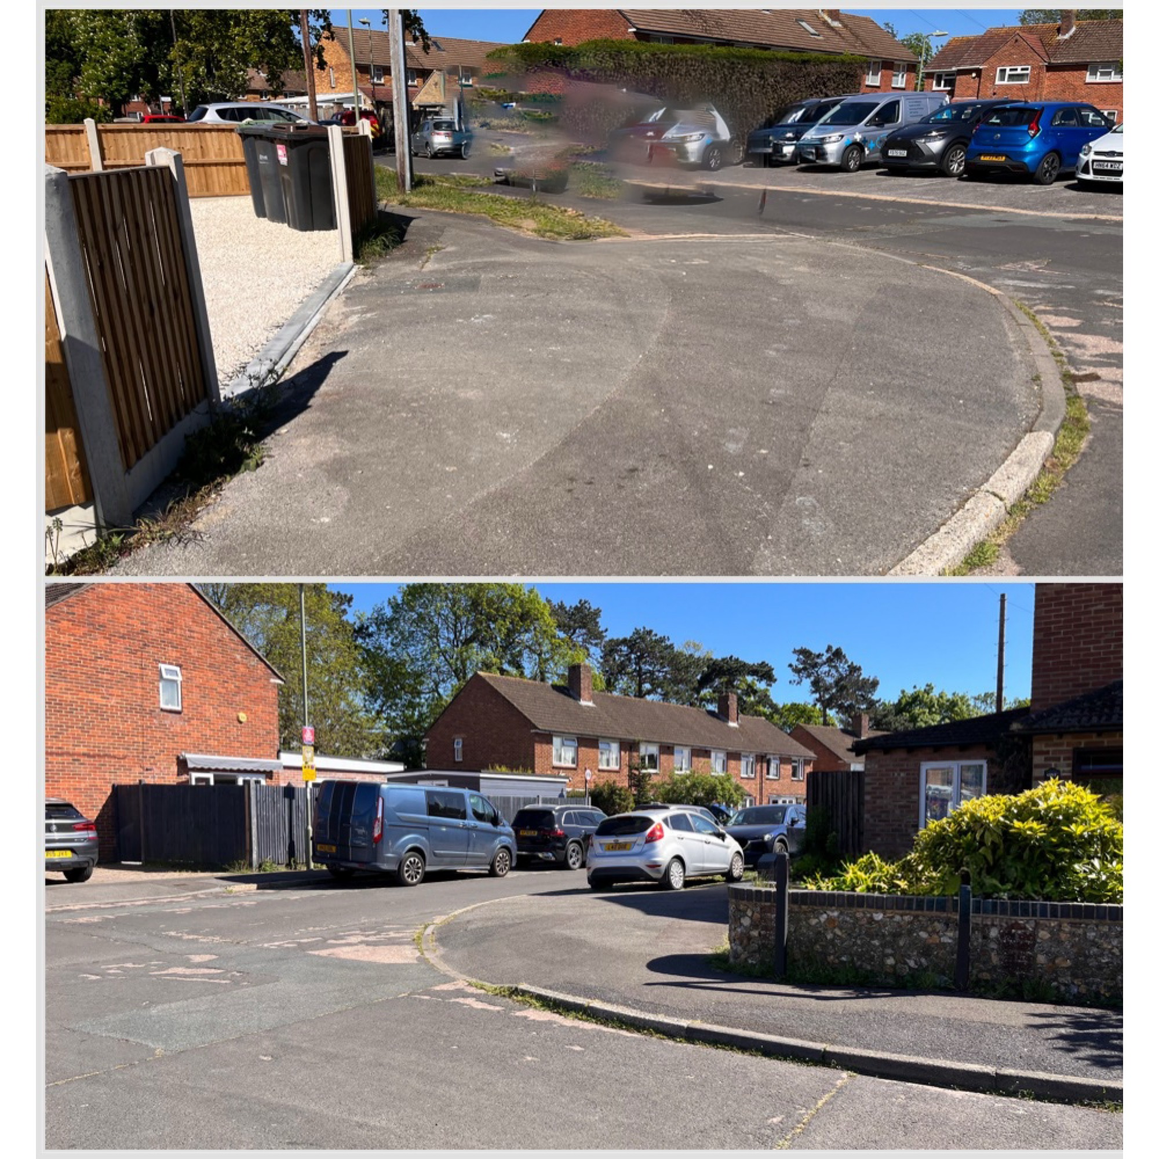

Slide 8
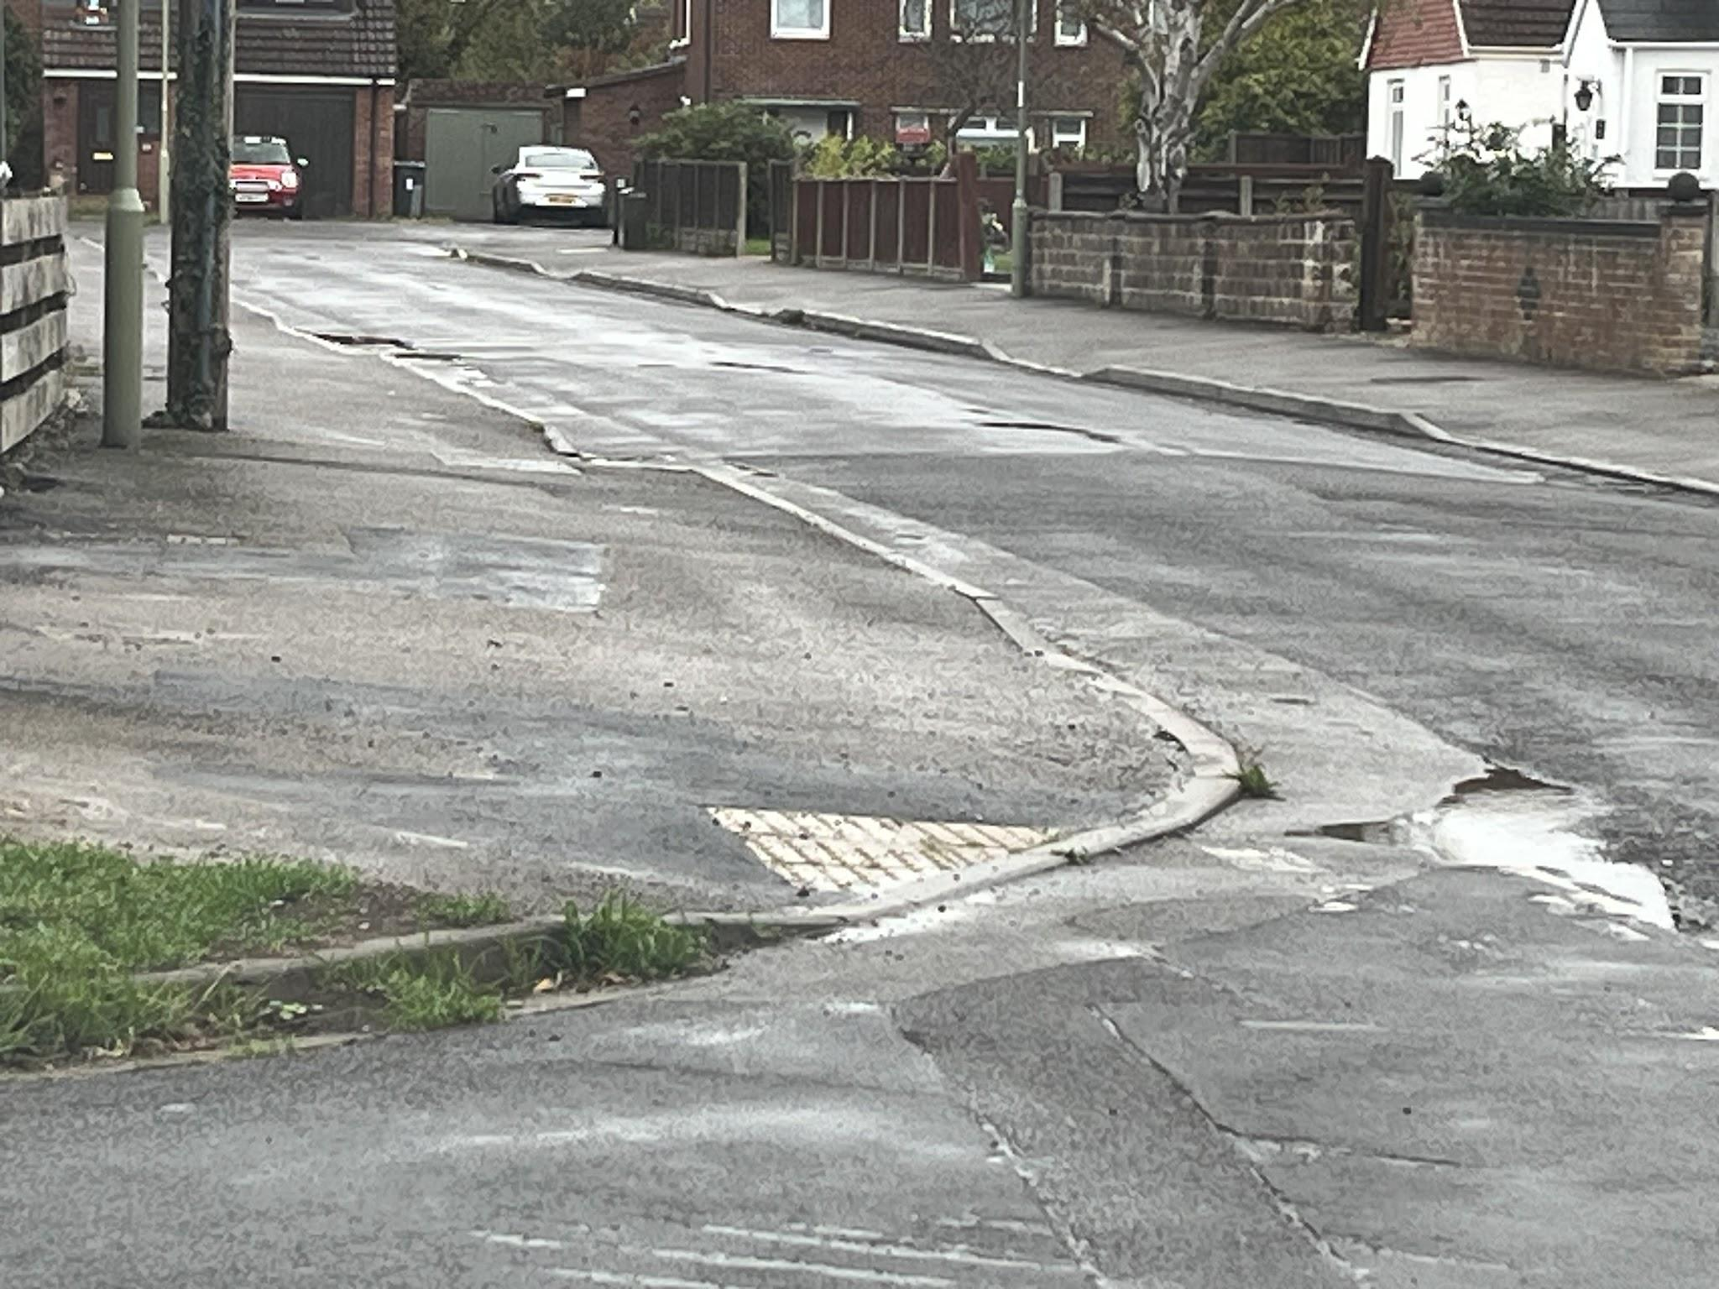

Slide 9
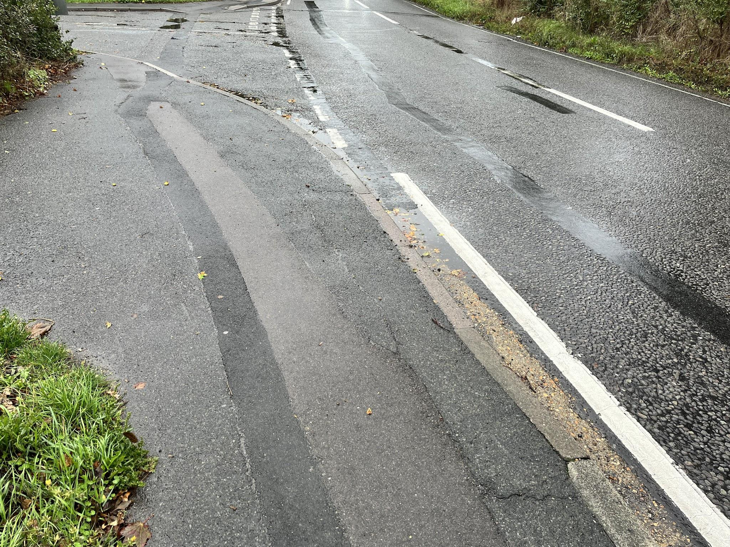

Slide 10
